Slide 1


Soccer Game Outcome Modelling
Rıdvan Sözen Yavuz Selim Uçar Mehmet Mücahit Sayar

Slide 2


Our Agenda
Data Selection
01
Data sources, features and their descriptions
Statistical Analysis
02
Statistical explorations of features and a discussion on using strategies wih correlations map
ML Methods
03
ML methods used, their definitions and significance on prediting soccer game outcomes
Results
04
Results of emlopyed ML methods and comments

Slide 3

Source of Data
European Soccer Database
https://www.kaggle.com/hugomathien/soccer
https://www.football-data.co.uk/data.php
Scores, Lineups, Team Formation and Events Data
http://football-data.mx-api.enetscores.com/
Players and Teams Attributes from EA Sport FIFA Games
http://sofifa.com/

Slide 4





A Brief Look
98%
5 Leagues
15.459 observations
More than 43 features for each team and player

Slide 5
Features
home_or_away : Which team is home team
home_player_overall(1-11) : Home players’ overall ratings
home_player_defenders : How many defence player does home team have
home_player_forwards : How many forward player does home team have
Last_5_match_win_home : How many wins does home team have in its last 5 matches
Last_5_match_goal_diff_home : Goal difference that home team has in its last 5 matches
Last_5_match_card_home : Home team’s card score in its last 5 matches
Last_5_match_faul_home : How many fauls does home team commit in its last 5 matches
Last_5_match_corner_home : How many corners does home team have in its last 5 matches
Last_5_match_shout_total_home : How many shouts does home team have in its last 5 matches
Last_5_match_shout_rate_home : Shout accuracy of home team in its last 5 matches
Last_5_match_shout_on_home : How many accurate shout does home team have in its last 5 matches
Team_variance_home : Variance of home team’s players
Last_5_match_btw_home : How many wins does home team have against away team

Slide 6
Features
away_player_overall(1-11) : Away players’ overall ratings
away_player_forwards : How many forward player does away team have
away_player_defenders : How many defence player does away team have
Last_5_match_win_away : How many wins does away team have in its last 5 matches
Last_5_match_goal_diff_away : Goal difference that away team has in its last 5 matches
Last_5_match_card_away : Away team’s card score in its last 5 matches
Last_5_match_faul_away : How many fauls does away team commit in its last 5 matches
Last_5_match_corner_away : How many corners does away team have in its last 5 matches
Last_5_match_shout_total_away : How many shouts does away team have in its last 5 matches
Last_5_match_shout_rate_away : Shout accuracy of away team in its last 5 matches
Last_5_match_shout_on_away : How many accurate shout does away team have in its last 5 matches
Team_variance_away : Variance of away team’s players
Last_5_match_btw_away : How many wins does away team have against away team

Slide 7
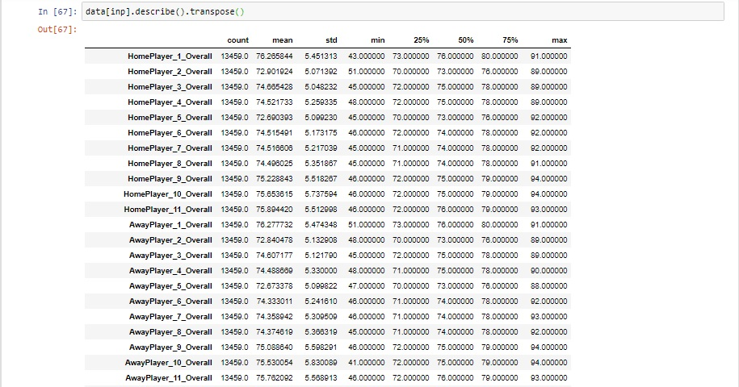
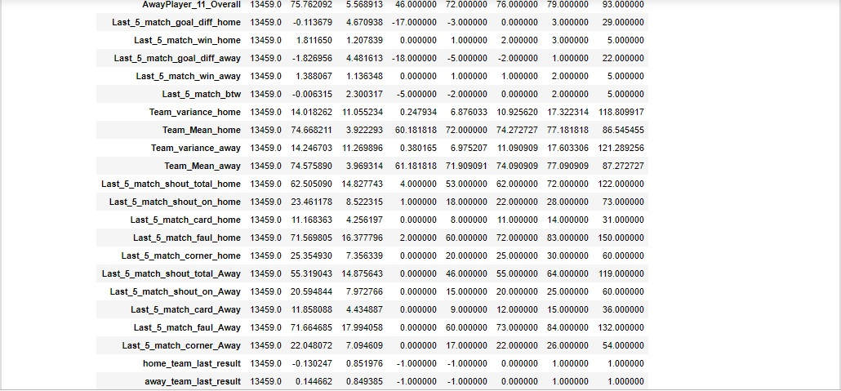
Statistical Exploration of Features
Text Here
Easy to change colors, photos and Text.

Slide 8

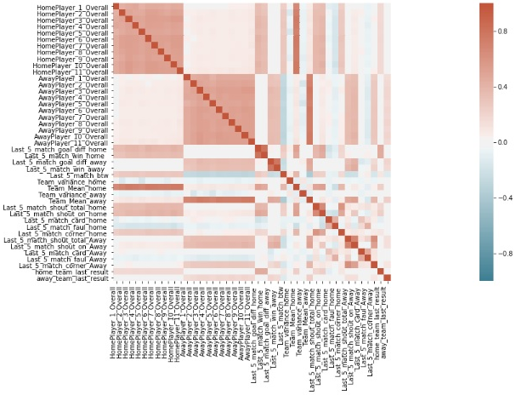
Correlations
No serial correlation among independent variables
No feature reduction before dimensionality reduction

Slide 9

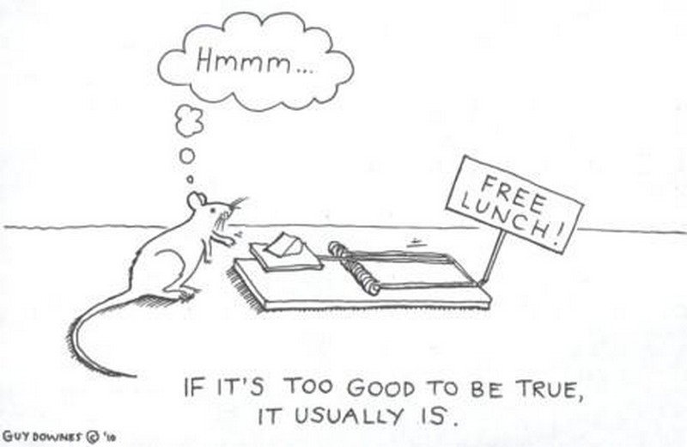

Slide 10
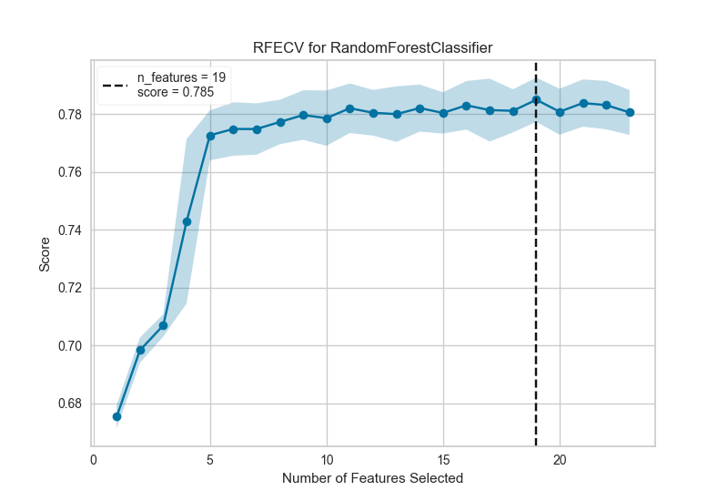
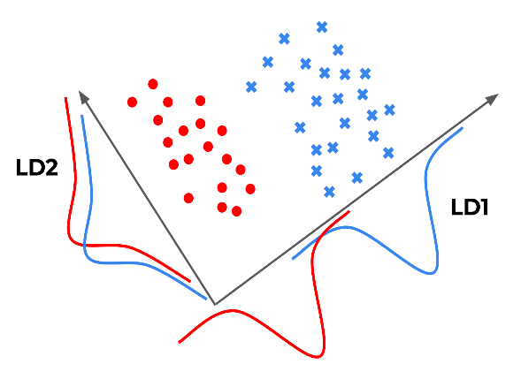
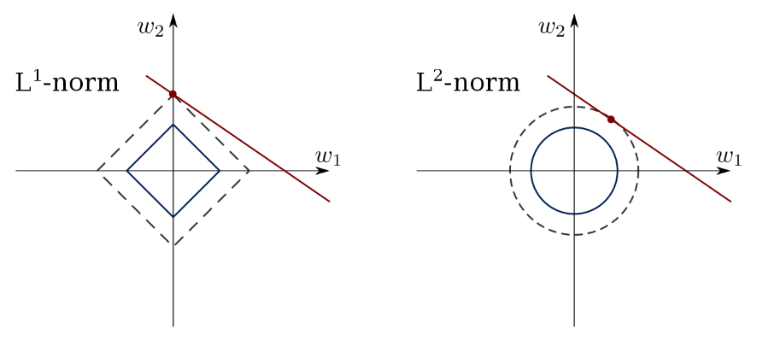


Feature Selection and Extraction
Content Here
that is beautifully designed.
Content Here
Get a modern PowerPoint Presentation that is beautifully designed.
RFE
Recursive Feature Elimination
LDA
LASSO
Linear Discriminant Analysis
Least Absolute Shrinkage and Selection Operator
Content Here
PCA
RAW DATA
Get a modern PowerPoint Presentation that is beautifully designed.
Principal Component Analysis
Principal data without reduction

Slide 11
ML Methods

Slide 12
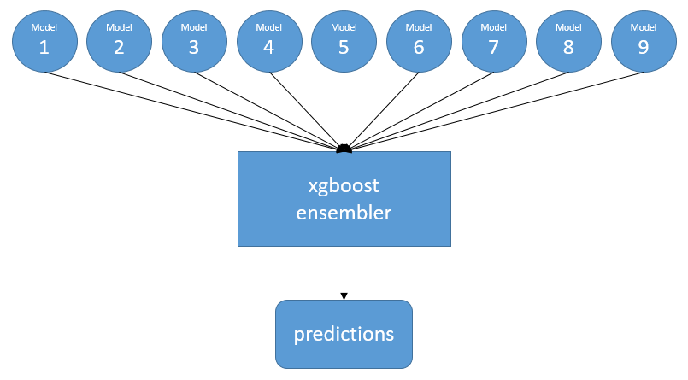

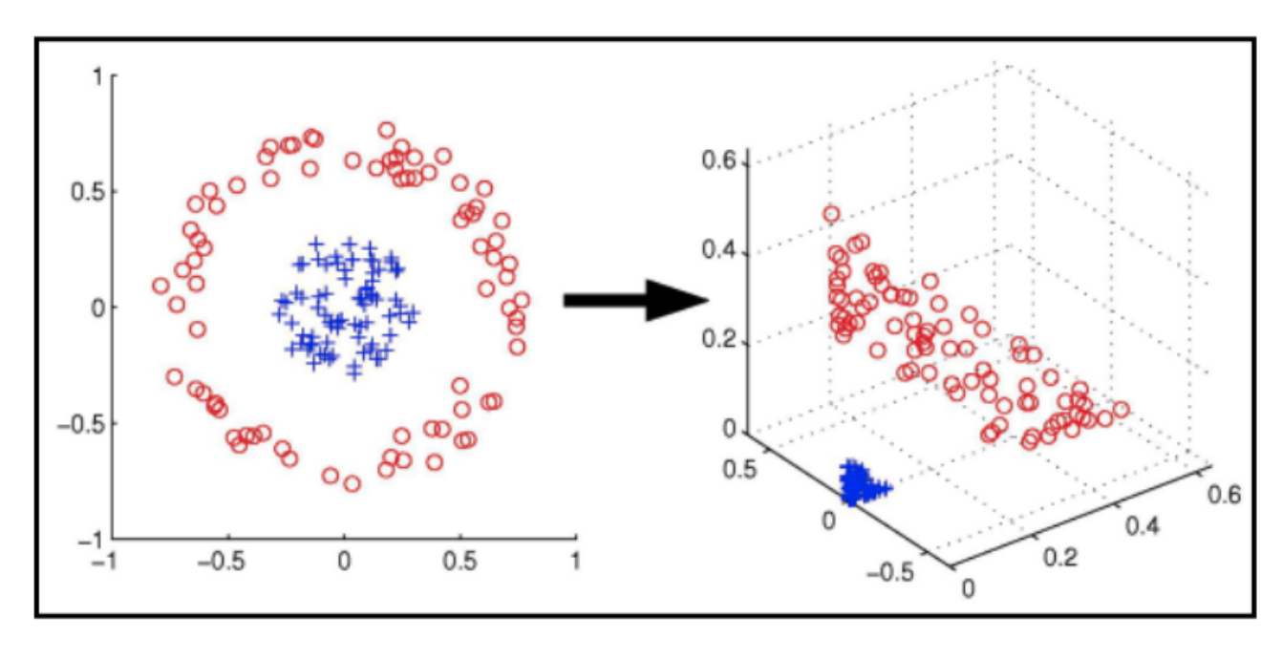
AWESOME
SLIDE
PEDIT.
XGBoost
Artificial Neural Network
Support Vector Machine
We use ensemble approach which consist of superwised learning meta algorithms for predicting output target feature by aggregating individual learning algorithms to lower their variance error source or by boosting sequantially built once to simultaneously lower their squared biased error and variance error sources.
We use multi-layer perceptron method which consists of superwised network based on learning algorithms for predicting output target feature by dynamically processing output target and imput predictors data through multi-layer network of optimally weighted connections of nodes.
It consists of superwised boundary based learning algorithm for predicting output target feature by seperating output target and input predictor features data into optimal hiperplanes.

Slide 13
RESULTS
1
4 Dimensionality Reduction Methods
2
3 ML Methods
3
15 Different Results

Slide 14
 | F1Score | AccuracyRate | MSE | MAE | PrecisionScore
XGBoostesulterWithRawDatA | 0,438952 | 0,567979 | 0,985029 | 0,611441 | 0,503162
XGBoostesulterWithLassot | 0,433615 | 0,56575 | 0,988417 | 0,615156 | 0,489139
ANNWithRawDatA | 0,412166 | 0,555349 | 1,019133 | 0,642645 | 0,693484
XGBoostesulterWithLDA | 0,387466 | 0,544577 | 1,037377 | 0,662333 | 0,36303
XGBoostesulterWithRFE | 0,386066 | 0,541976 | 1,042913 | 0,667905 | 0,44317
SVMWithLDA | 0,383401 | 0,541976 | 1,043981 | 0,668648 | 0,364054
ANNWithLDA | 0,384809 | 0,541605 | 1,044692 | 0,669391 | 0,36033
ANNWithLassot | 0,414265 | 0,54049 | 0,988793 | 0,632244 | 0,488981
ANNWithRFE | 0,320436 | 0,514859 | 1,094699 | 0,722883 | 0,379093
XGBoostesulterWithPCA | 0,313996 | 0,47214 | 1,167763 | 0,806464 | 0,369558
SVMWithRawDatA | 0,213124 | 0,469911 | 1,17395 | 0,812779 | 0,156637
SVMWithPCA | 0,213124 | 0,469911 | 1,17395 | 0,812779 | 0,156637
SVMWithLassot | 0,213124 | 0,469911 | 1,17395 | 0,812779 | 0,156637
SVMWithRFE | 0,213124 | 0,469911 | 1,17395 | 0,812779 | 0,156637
ANNWithPCA | 0,329657 | 0,468053 | 1,159463 | 0,802749 | 0,39377

Slide 15

Highest Accuracy
XGBoost with LASSO
XGBoost with Raw Data
Accuracy Rate
Accuracy Rate
56%
56%
MEAN SQUARE ERROR
MEAN SQUARE ERROR
~0,99
~0,98
However, other methods that we use are not useless since their accuracy rates varies between 46 percent and 56 percent. So, we can conclude that any method we use in our prediction model can give us the expected results.
In addition, those methods which we get the highest accuracy rates are also with the lowest MSE scores. This supports XGBoost is the most suitable method to use.

Slide 16

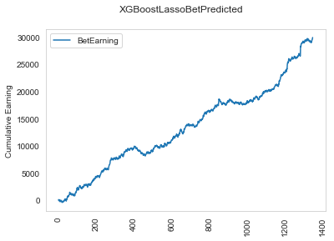
What if we bet with our algorithm?

Slide 17

Thank You

